Slide 1


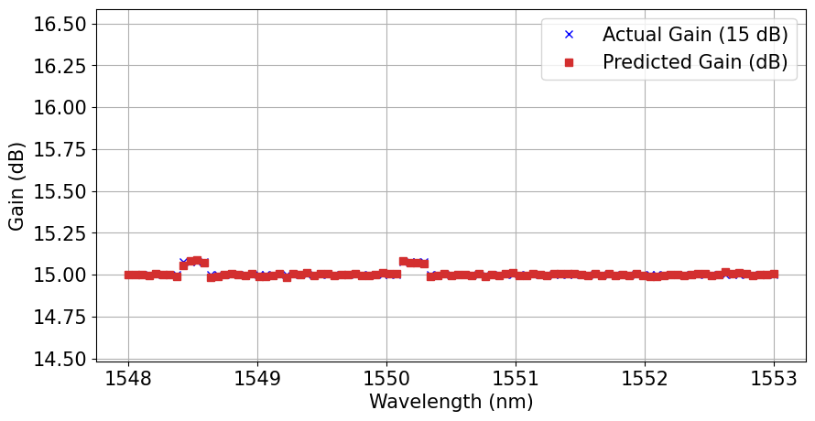
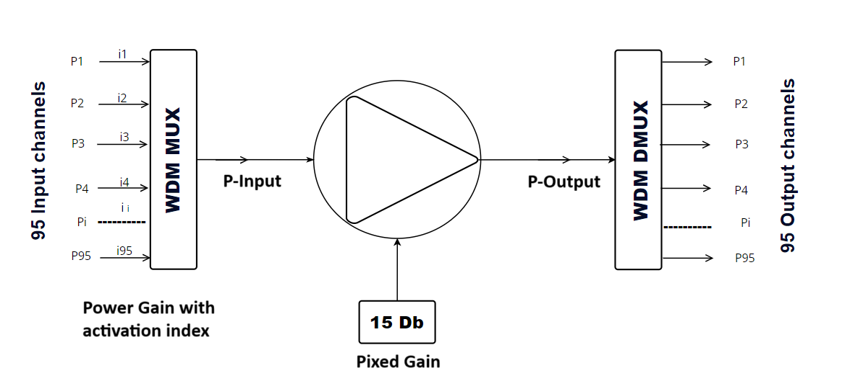
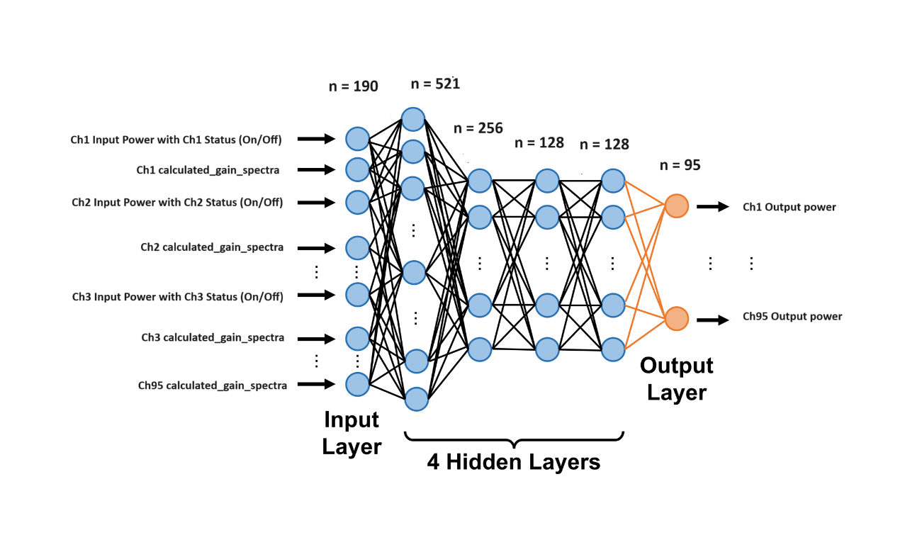
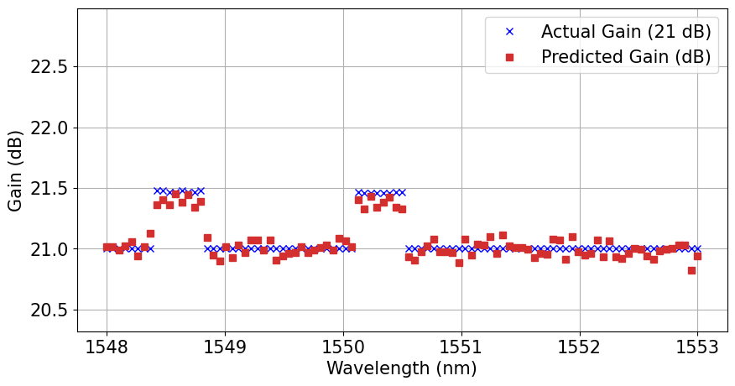
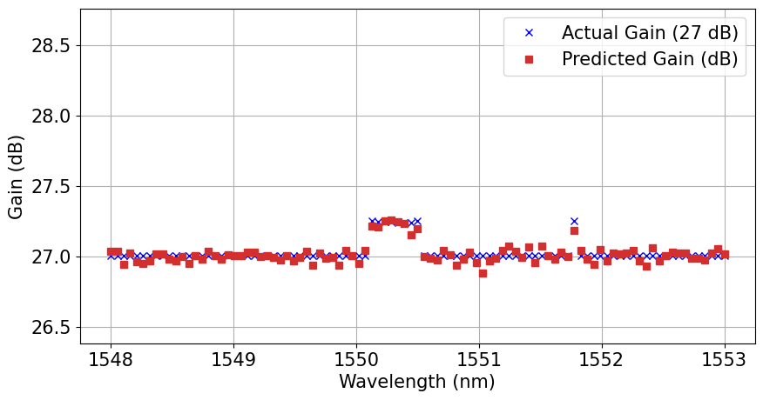
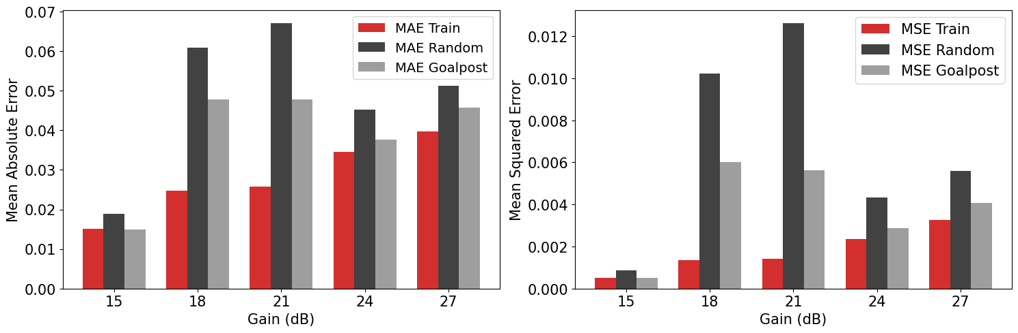
Erbium Doped Fiber Amplifier (EDFA) Gain
Modeling by Machine Learning
Anil Kumar Raigar (nlr23rks@bangor.ac.uk), Supervisor: Md Saifuddin Faruk
School of Computer Science and Electronic Engineering
https://github.com/anilkrp/EDFA_Gain_Modelling_Dissertation/tree/main
Introduction
Training & Optimization: Train the model using RMSprop and Adam optimizers, applying a LeakyReLU with alpha=0.1 to prevent overfitting.
Model Evaluation: Assess model performance through calculate metrics like MAE and MSE and Losses across multiple test datasets.
EDFA gain is crucial for amplifying optical signals in communication networks, ensuring efficient data transmission over long distances.
Machine learning models are powerful tools that can predict complex behaviors like EDFA gain by learning patterns from large datasets.
In this study, a deep neural network was developed to model EDFA gain, achieving high accuracy with MAE of 0.0151 and MSE of 0.0005.
Objective
The images illustrate a 95-channel wavelength division multiplexing (WDM) system. On the left, a WDM multiplexer combines 95 input signals, amplifies them, and then sends them through a demultiplexer to produce the output signals. On the right, a deep neural network with four hidden layers is used to predict the output power of each channel. It does this by taking the input power, channel status, and calculated gain as inputs, producing the output for all 95 channels.
Develop a deep neural network to accurately predict EDFA gain, achieving high precision with performance metrics such as MAE and MSE.
Optimize the neural network architecture by implementing Leaky ReLU activation with alpha=0.1 applying to minimize overfitting and enhance generalization.
Evaluate the model's performance by comparing predicted vs. actual EDFA gain, calculating MSE, MAE, and analyzing prediction error across various channels and wavelengths.
Integrate the model into an optical communication system and assess its reliability by testing under different network conditions, channel configurations, and noise levels.
Result and Discussion
Achieved high accuracy in predicting EDFA gain across 95 channels using a Deep Neural Network (DNN).
Demonstrated improved performance and strong generalization on test datasets.
Training accuracy: 98.5%, with MAE of 0.0151 and MSE of 0.0005.
Test accuracy: 97.8% on unseen data, showing minimal performance drop.
Error metrics: Low and consistent errors across 15-27 dB gain levels.
Gain prediction: Accurate across all tested gain levels, ensuring reliability.
These plots compare the actual and predicted gain spectra at 15 dB, 21 dB, and 27 dB across the wavelength range of 1548 nm to 1553 nm. The DNN model consistently aligns with the actual data, demonstrating high accuracy in predicting EDFA gain across varying gain levels.
Methodology
Conclusion
Data Preprocessing: Convert raw data from JSON to CSV format, normalize the features between 0 and 1, and handle missing values using mean imputation for consistent model training input.
Feature Engineering: Design new features such as effective input power, combining channel states and signal strength, to enhance prediction accuracy.
Model Development: Construct a Deep Neural Network (DNN) with four hidden layers, using Leaky ReLU activation to capture non-linear relationships
Successfully modeled EDFA gain with improved prediction accuracy.
Achieved MAE of 0.0151 and MSE of 0.0005.
Future work will explore LSTM and Transformers for more accurate predictions.
Reference: Wang, Z., Kilper, D.C., & Chen, T. (2023). Open EDFA gain spectrum dataset and its applications in data-driven EDFA gain modeling. Journal of Optical Communications and Networking, 15(9), 588-599.
This figure shows the MAE and MSE for training, random, and goalpost datasets across different EDFA gain levels. The model performs well, with lower errors observed in the random and goalpost tests.

